Slide 1
Orographic Precipitation Associated with Outer Rainband of Typhoon Fitow (2013)
Huaning DAI, Kun ZHAO, Xiaomin CHEN, Mingjun WANG Nanjing University, China
Notes:
Name，school，topic

Slide 2
Outlines
Introduction
Case Overview
Data and Method
Result
Conclusion
Notes:
My presentation will be structured in these following parts

Slide 3
1. Introduction : TC track and topography in eastern China
When TCs make landfall in eastern China coastal area, they often result in heavy rainfall due to their interaction with local Terrain.
Notes:
Firt introduction，as we all know，eastern china coast is one of the most frequent area tropical cyclone make landfall in. Since there are several mountains and hills locate the area, heavy rainfall can occur under the interaction between local terrain and TCs.
https://depts.washington.edu/chinaciv/geo/land.htm

Slide 4
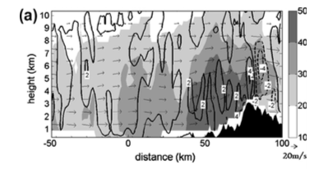
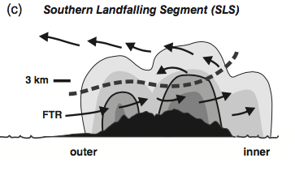
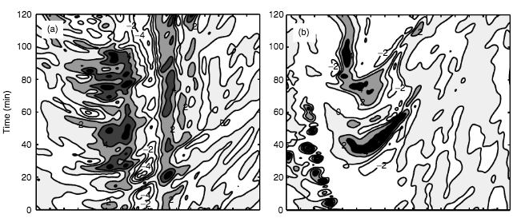
1. Introduction : Former study about Taiwan topography
1. Lifting of convective cells by topography trigger precipitation (Liou et al. ,2013)
2. The seeder-feeder mechanism is responsible for rainfall enhancement for lower topography in southern Taiwan(Yu and Cheng , 2013)
3. Blocking effect; rainband structure change during pass over topography (Yu and Tsai, 2017)
4. Mountain-induced gravity wave (Tang et al. ,2012)
(Houze 2012)
Notes:
The topography in Taiwan for example, several different processes have been proved to be responsible for orographic rainfall in the area. Including lifting, seeder-feeder mechanism, blocking effect a

Slide 5
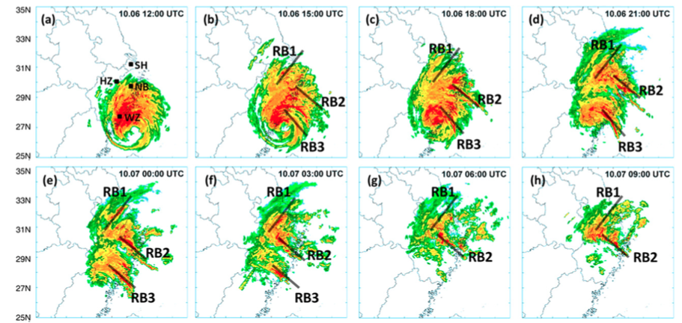
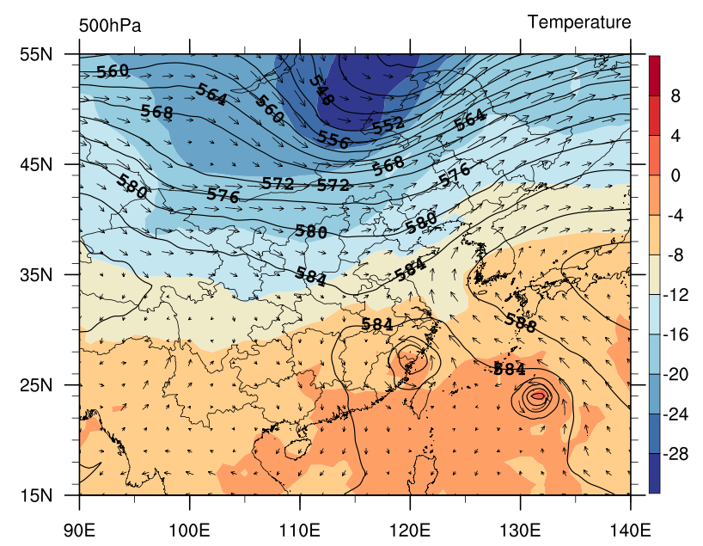
2. Case overview
Bao et al. (2015) :
Fitow
increasing injection of midlevel moist potential vorticity (PV) from the Fitow circulation;
low-level warm, moist inflow from the east;
midlevel inflow from nearby Typhoon Danas;
decreasing injection of mid- to upper-level PV from the mid-latitude trough.
Danas
Notes:
Secondly, the case overview of typhoon Fitow.
Fitow made landfall at eastern china coast while there was a mid-latitude trough take part at north of china and another tropical cyclone Danas take part in eastern china sea.
Bao and all 2015’s result shows that the total rainfall in the area was due to four environmental interaction with Fitow’s circulation.
The local orographic rainfall enhancement event was associated with the rainband 2 in their figure.

Slide 6
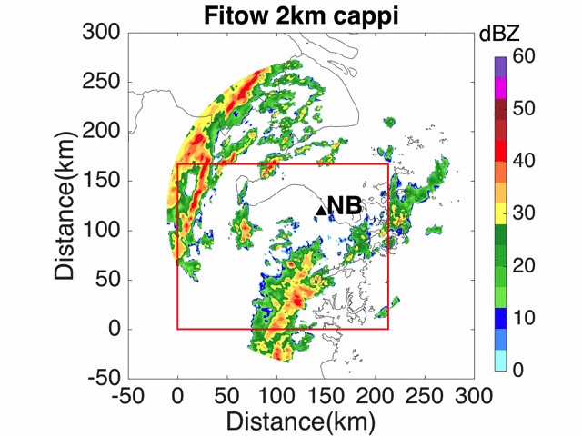
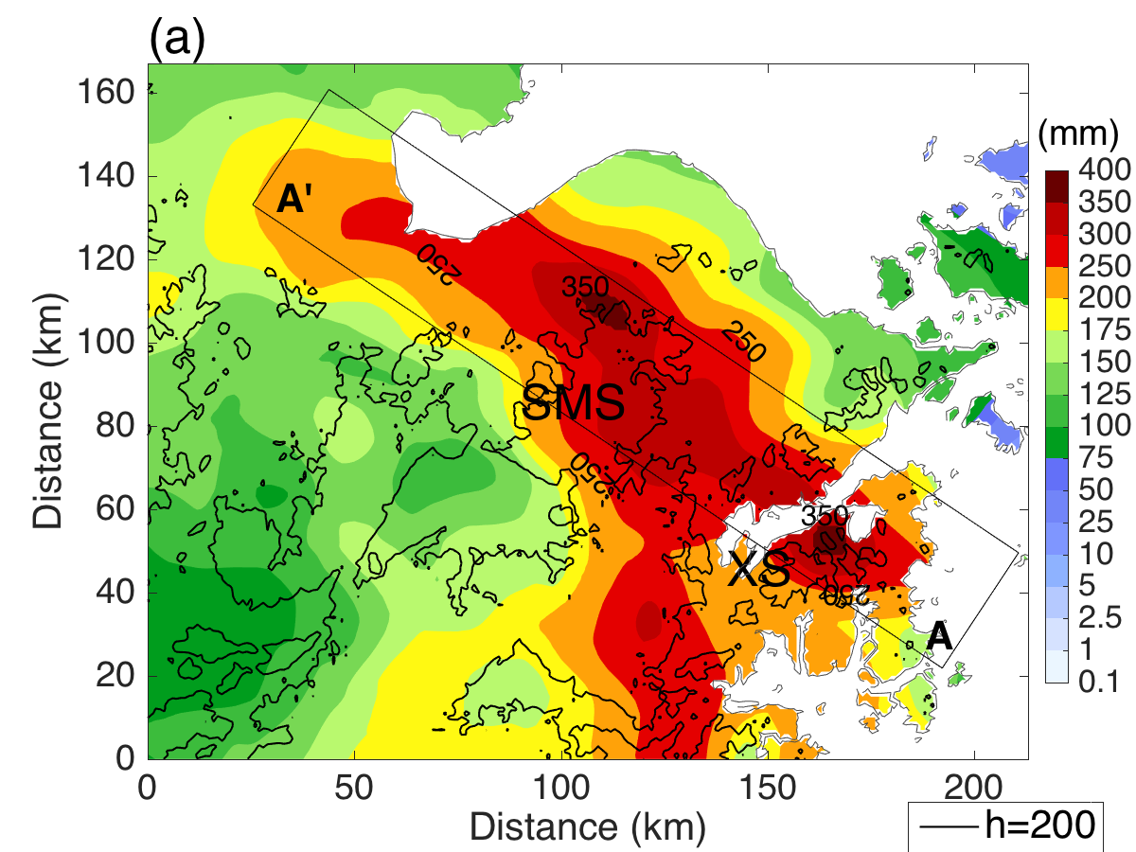
2. Case overview
24h Accumulated rainfall
NB radar 2km cappi and area accumulated rainfall during UTC 10-06 04:00 ~ 10-07 04:00
Notes:
Here are the cappi at 2km of NB radar and the accumulated rainfall in the red rectangle during universal time 4 am 6th October to 4 am 7th October.
As the rain band passed from south-east to north west, it result in a band-like rainfall area.
The rainfall center stands out, at XS , which is a small hill area at coast. Our investigation was mai nly about it, the other rainfall center at SMS moutain area also be investigated.

Slide 7
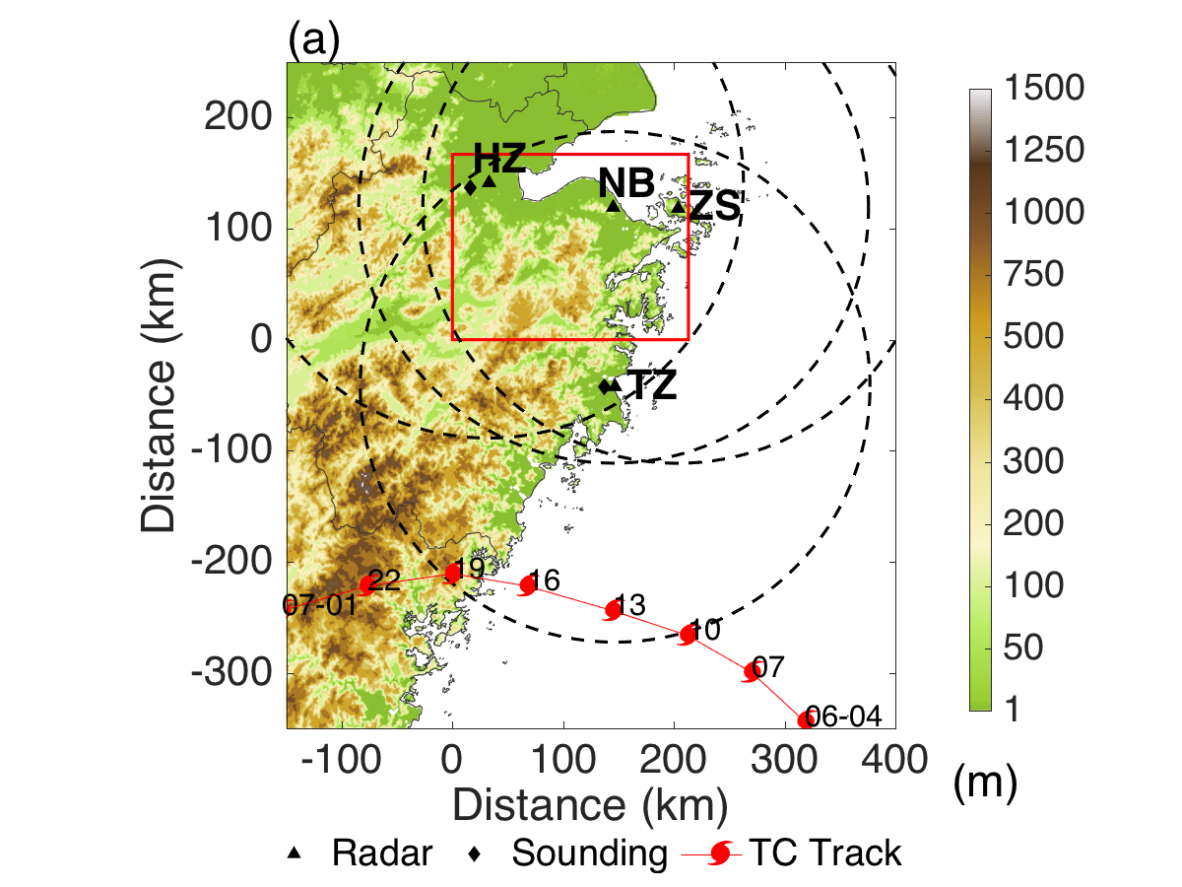
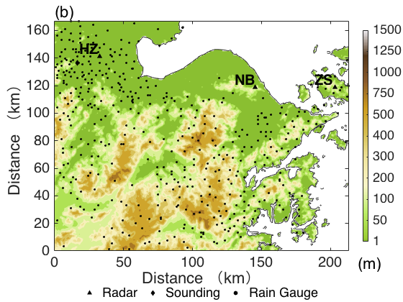
3. Data and method
Doppler radar network, rain gauge, sounding data
Tc track from UTC 10-06 04:00 ～ 10-07 01:00
Notes:
Third part, the data and method.
To investigate the rainfall event, we use a Doppler radar network which including 4 operational radars nearby, the rain gauge data in the area, and sounding data of nearby station.

Slide 8
3. Data and method
w
Vr1
Vr2
u
H represent terrain height
Traditional duel-Doppler
v
Method：
Liou et al. (2009,2012)：
Specific method to calculate u,v,w around topography boundary —— more accurate result
Using multiple radar data at same time, solve the problem around radar baseline
Notes:
We used the variational-based multiple-Doppler three-dimensional wind synthesis method developed by Liou and all 2009,2012. this method calculates the vertical motion induced by airflow when it pass over topography, which is not calculated in traditional duel Doppler retrieve method.
The benefit of using this method is we can get more accurated result around topography boundary, we can use multiple radar data for same area at same time. and it solve the problem around radar baseline.

Slide 9
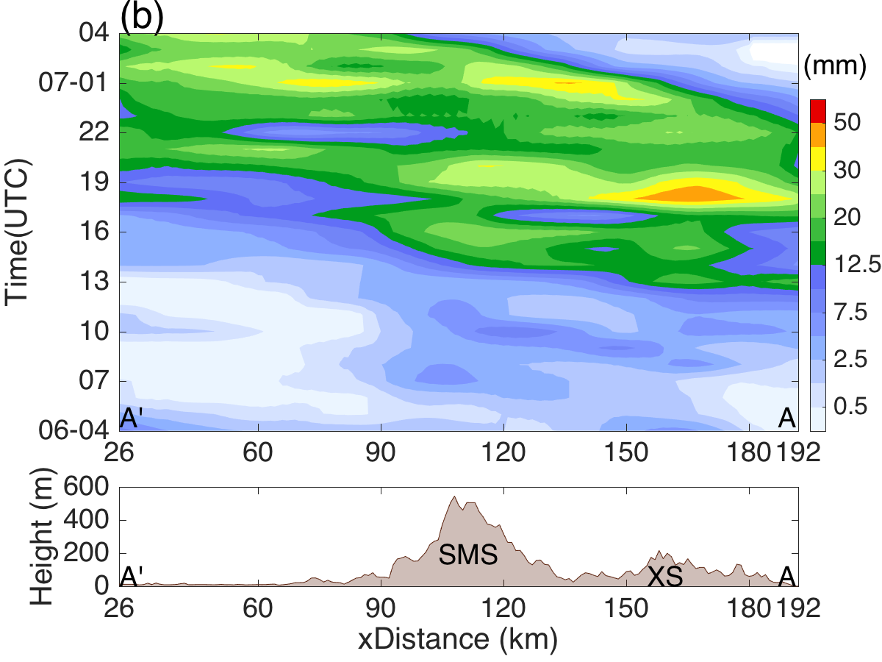
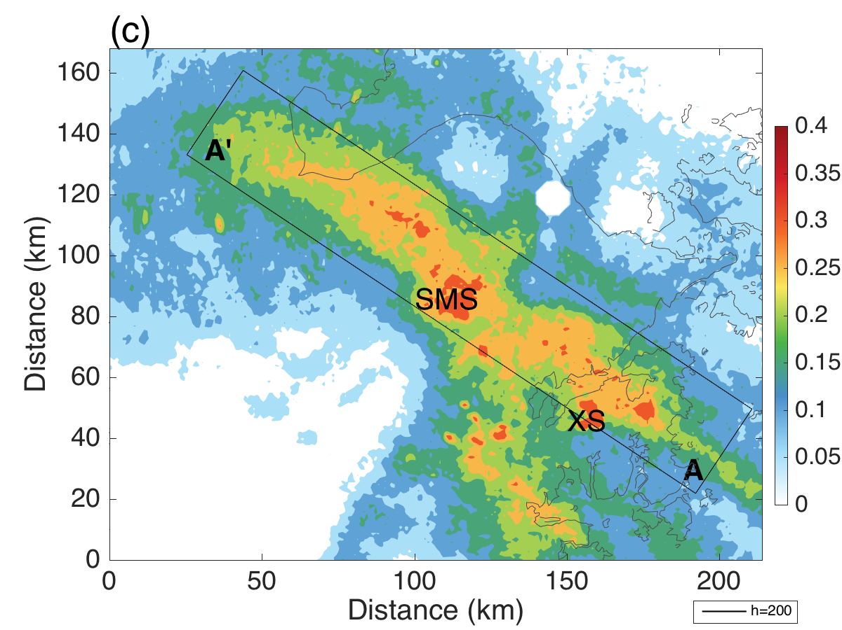
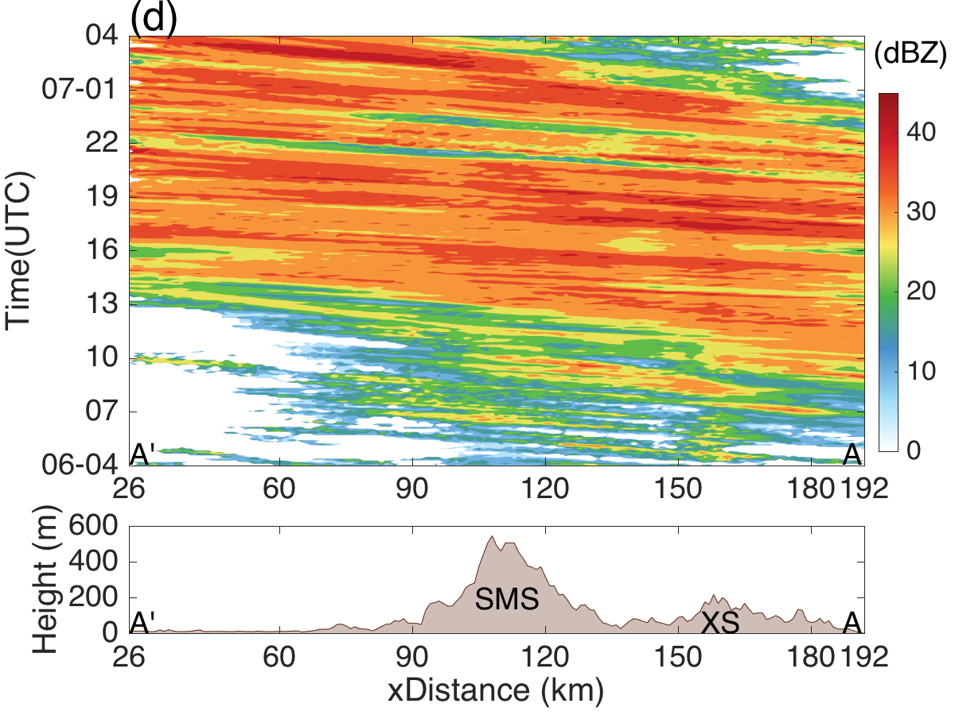
4. Results : Rainfall distribution
SMS2
SMS1
XS
Raingauge data
Raingauge data
SMS2
SMS1
XS
Frequency of reflectivity > 35dBZ
NB radar
Reflectivity 2km cappi NB radar
Notes:
These are the result.
First we cross check the rainfall calculated by raingauge with the NB radar data.
Figure (a),(b) for raingauge data, figure (c)(d) for NB radar data.
Both these result shows that there is 3 different center of rainfall around this area.
They are name by XS SMS1 SMS2 respectively.

Slide 10
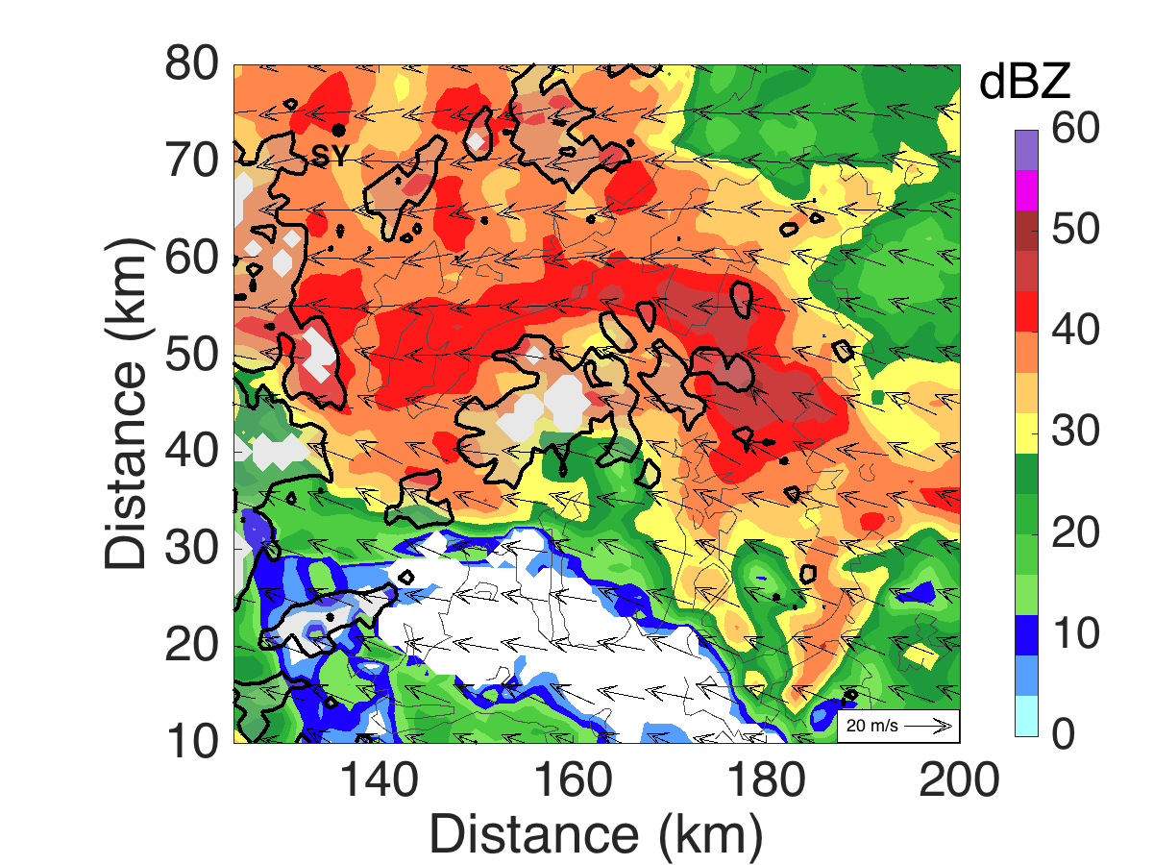
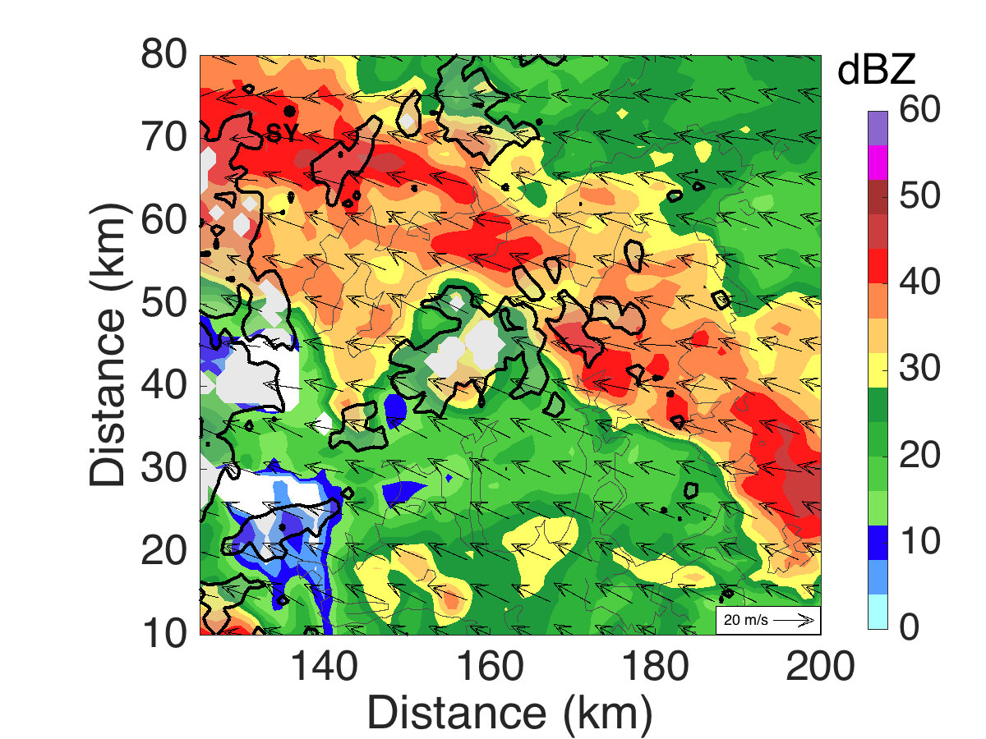
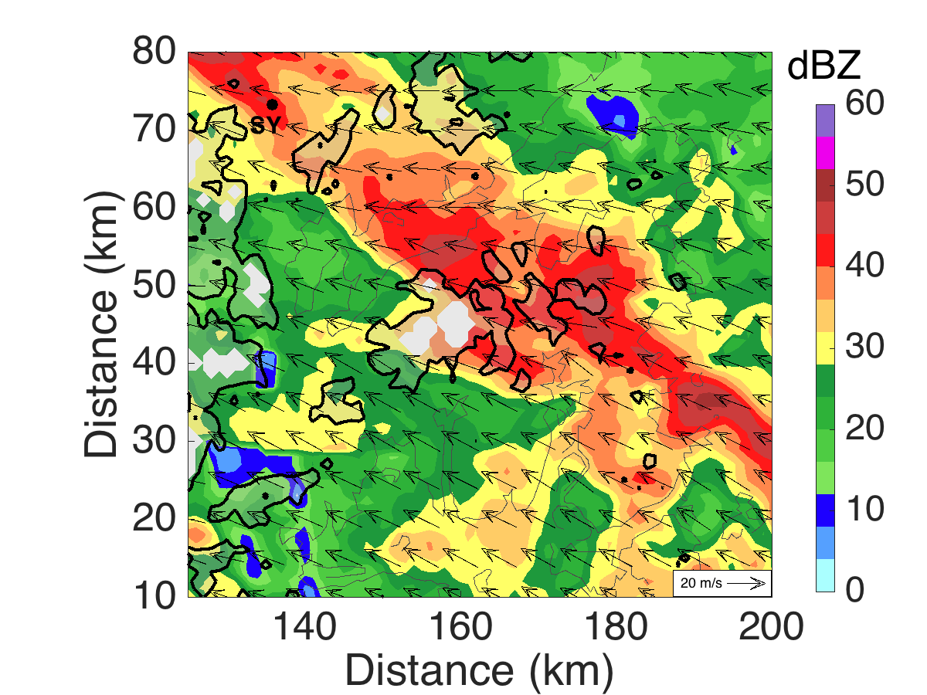
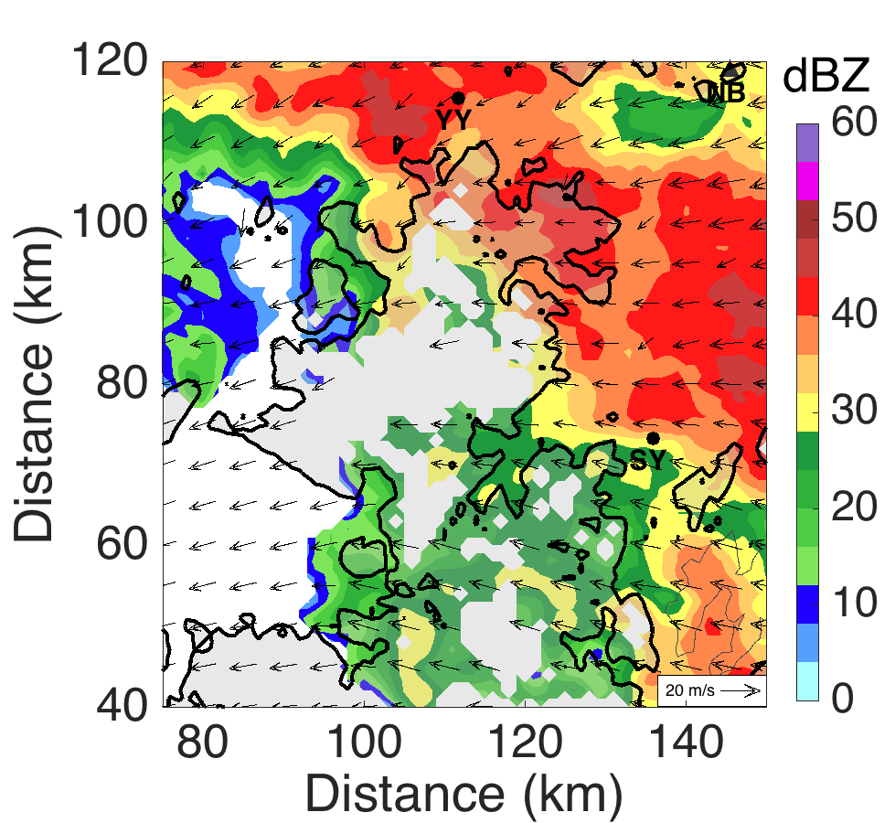
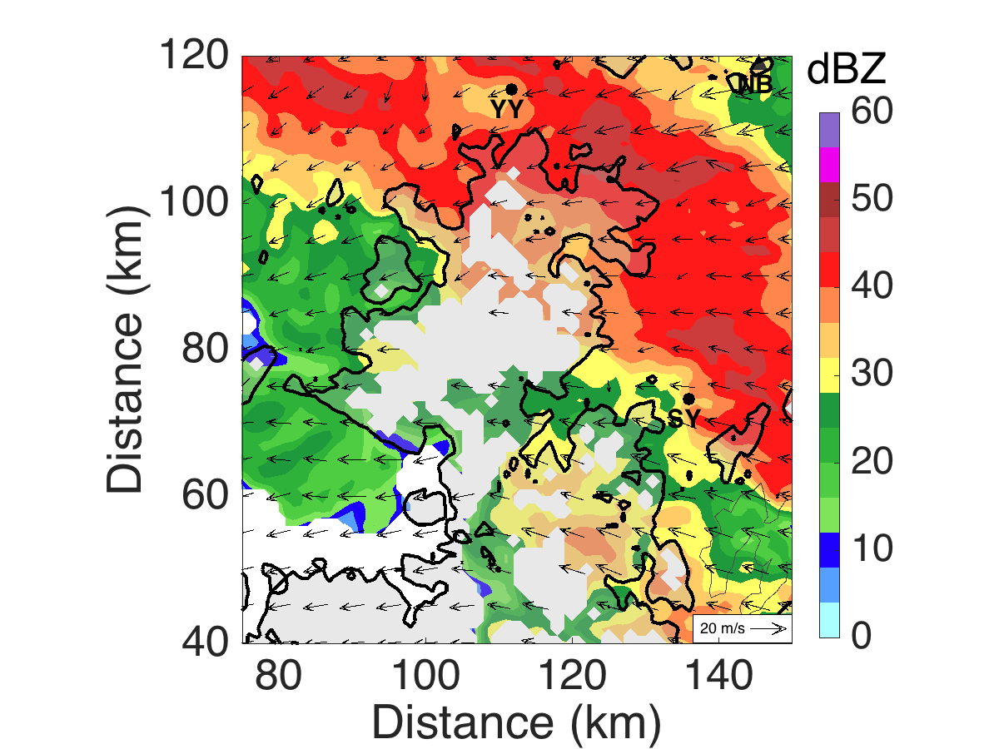
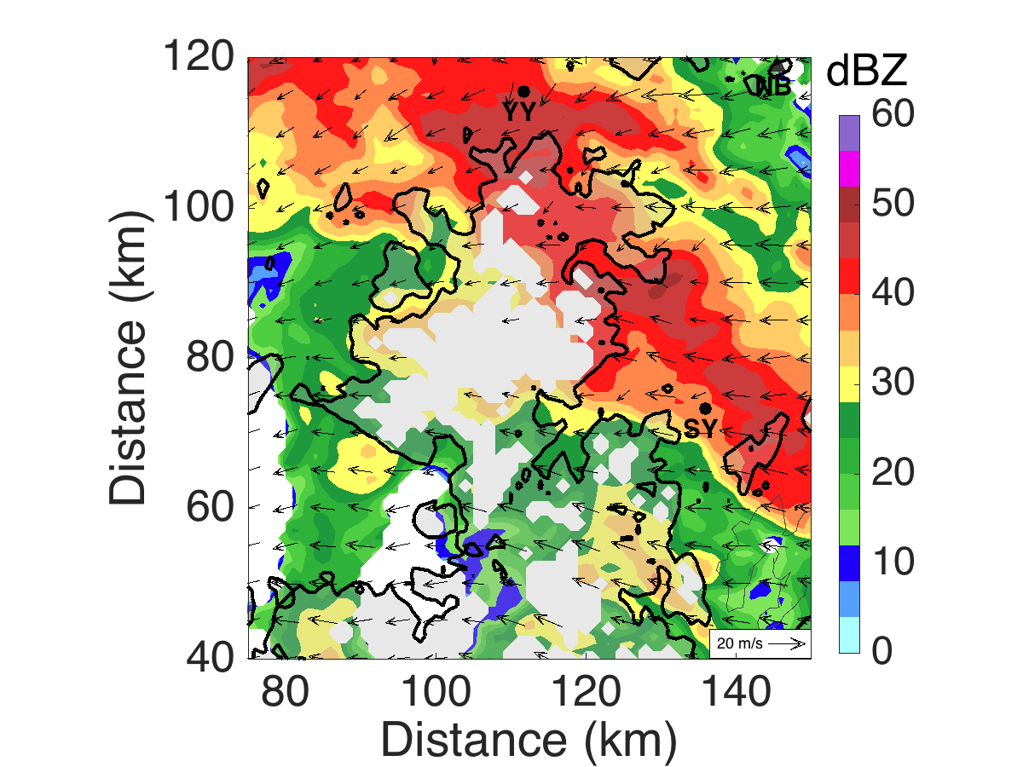
4. Result : Horizontal Winds at 0.5 km
UTC 10-06 17:30
18:00
18:30
XS
SMS
UTC 10-06 23:30
UTC 10-07 00:00
00:30
Notes:
The horizontal wind structure at 500m, shows that, XS area got a south-easterly low-level air flow which is near perpendicular to topography.
But for SMS area, the low-level air flow at critical time, was coming from 3 different direction, the interaction between low-level inflow was mor complicated.

Slide 11
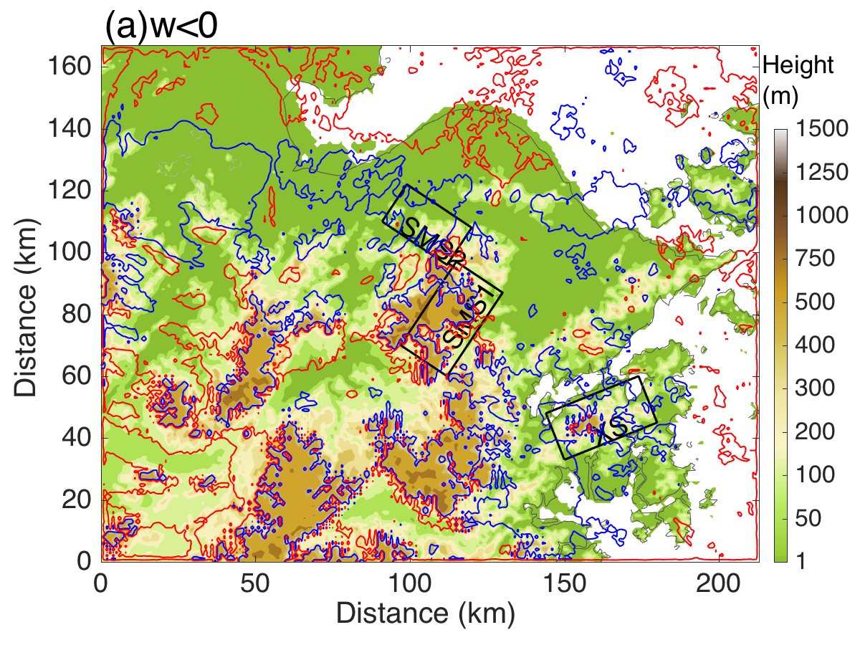
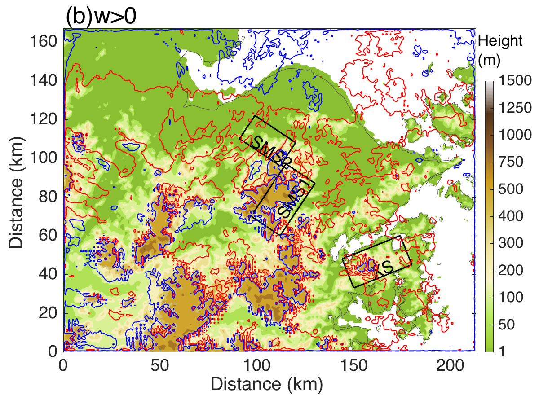
4. Result : Vertical Velocity
Similar frequency
More updraft than down draft
The frequency distribution of vertical velocity：
red ：30/49，blue 15/49
Notes:
This low-level airflow and its different angle, result in different vertical velocity distribution at different area.
The updraft at XS area was more frequent compare to dowmdraft. But For SMS1 area, there’s no significant different between frequency.

Slide 12
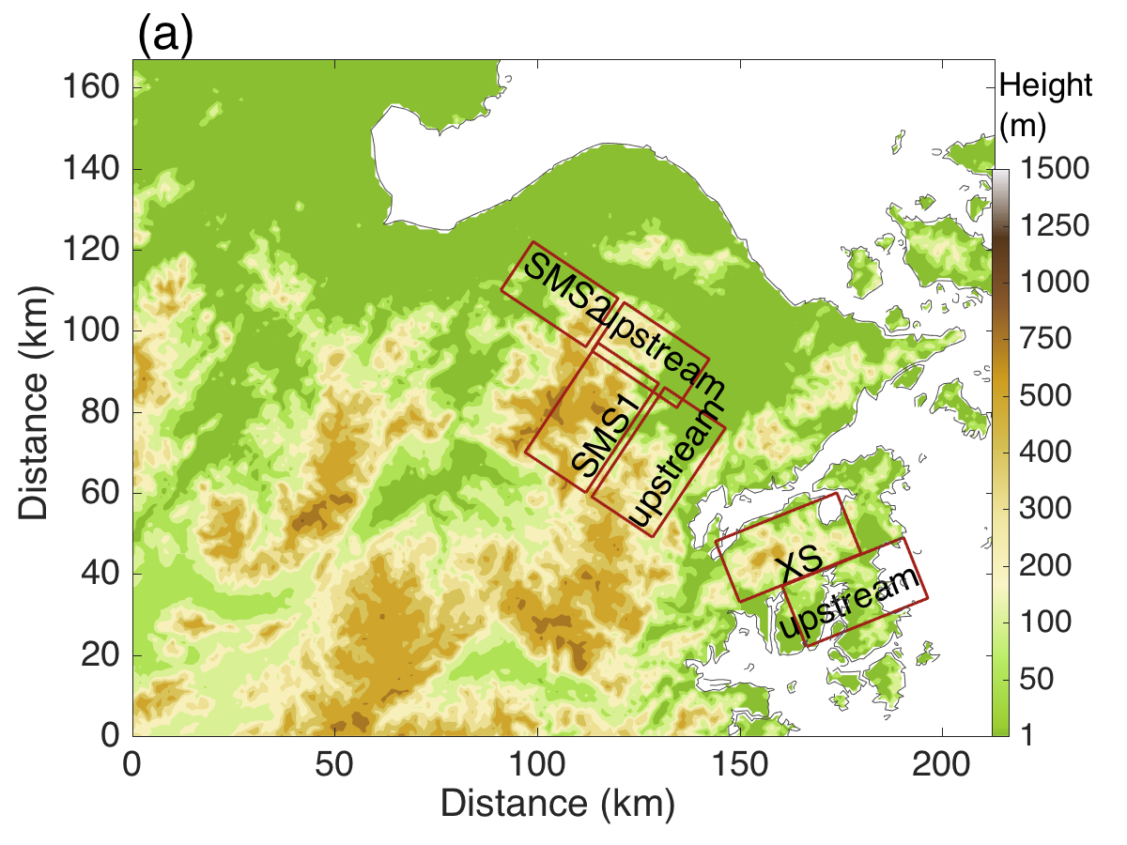
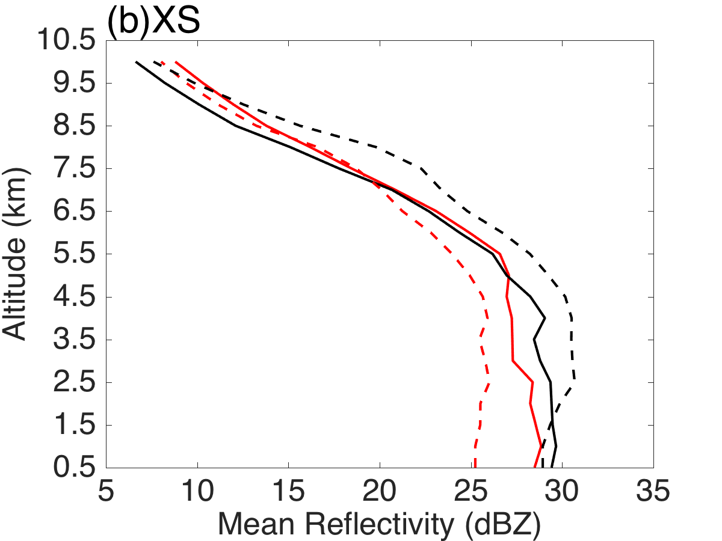
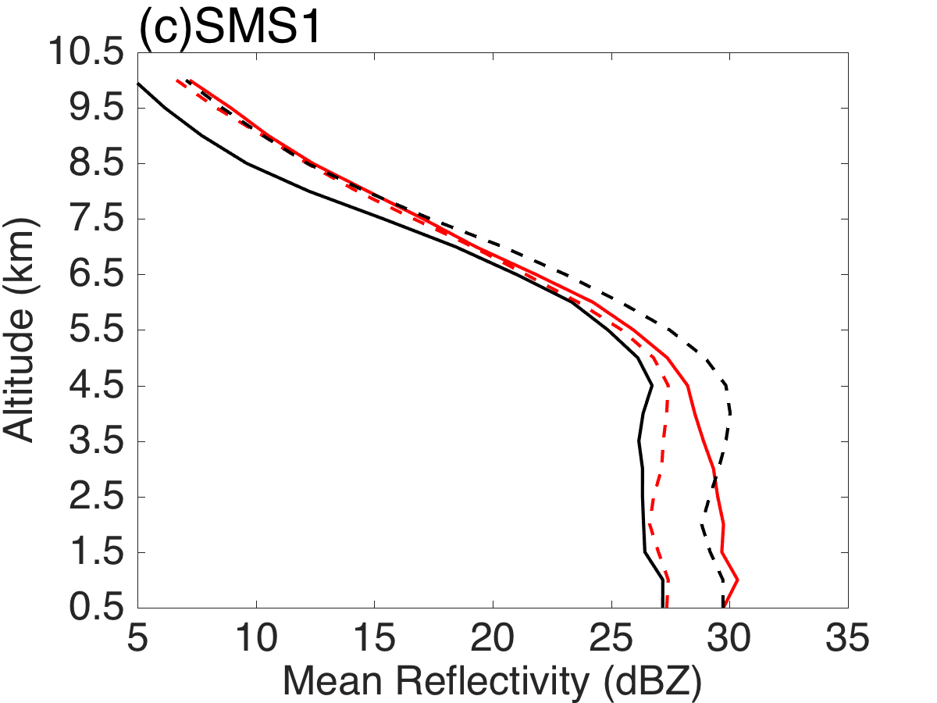
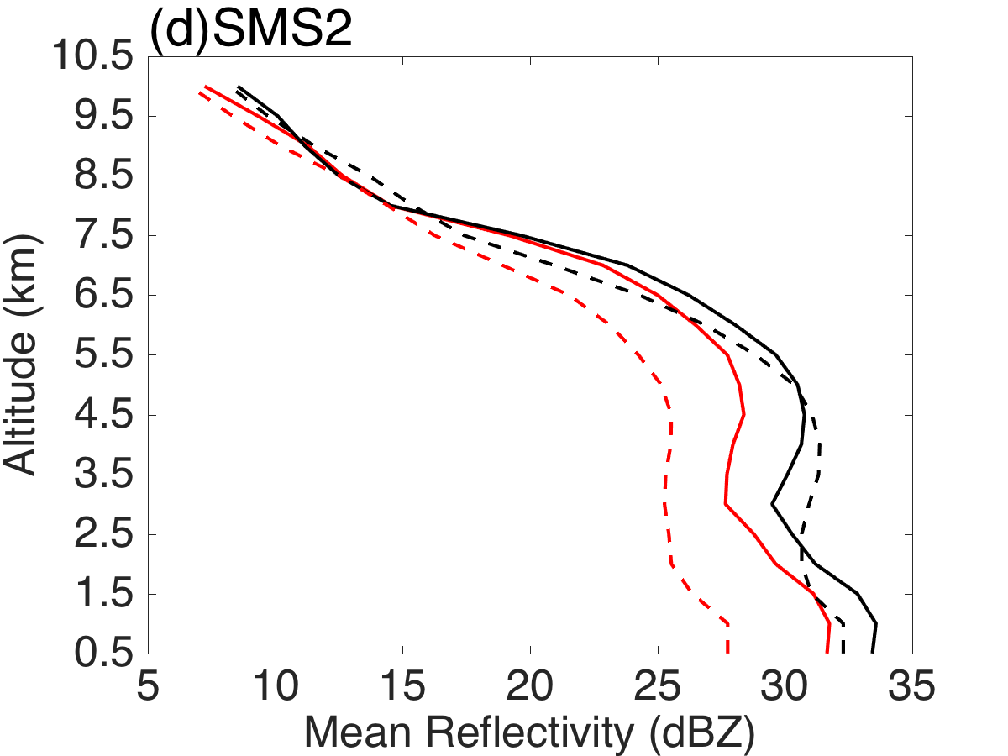
4. Result : Vertical profiles of radar reflectivity
Red：
rainfall area > upstream area
Black：
rainfall area < upstream area
Solid ——：
rainfall area
Dashed -----：
Upsteam area
Notes:
As for the vertical structure of rainfall in each area, these are the vertical profiles of radar reflectivity.
For each area, a upstream area in same size was chosen to compare with.
Red lines stand for hourly rainfall in area was greater than rainfall in upstream area
Black lines stand for rainfall in upstream area was greater
Solid lines stand for rainfall area mention before, dashed line stand for each upstream area.
For XS area the tendency of mean reflectivity shows that as the altitude goes down, the mean reflectivity of XS area increase, even if the hourly rainfall of is upstream area was greater. Mean reflectivity below 2km keep greater than it’s upstream area.
For SMS1 area, the tendency of mean reflectivity changed significantly for critical rainfall period.
SMS2 area, the tendency of each line are both similar.
These indicades that, the low-level process is important for this rainfall event.

Slide 13
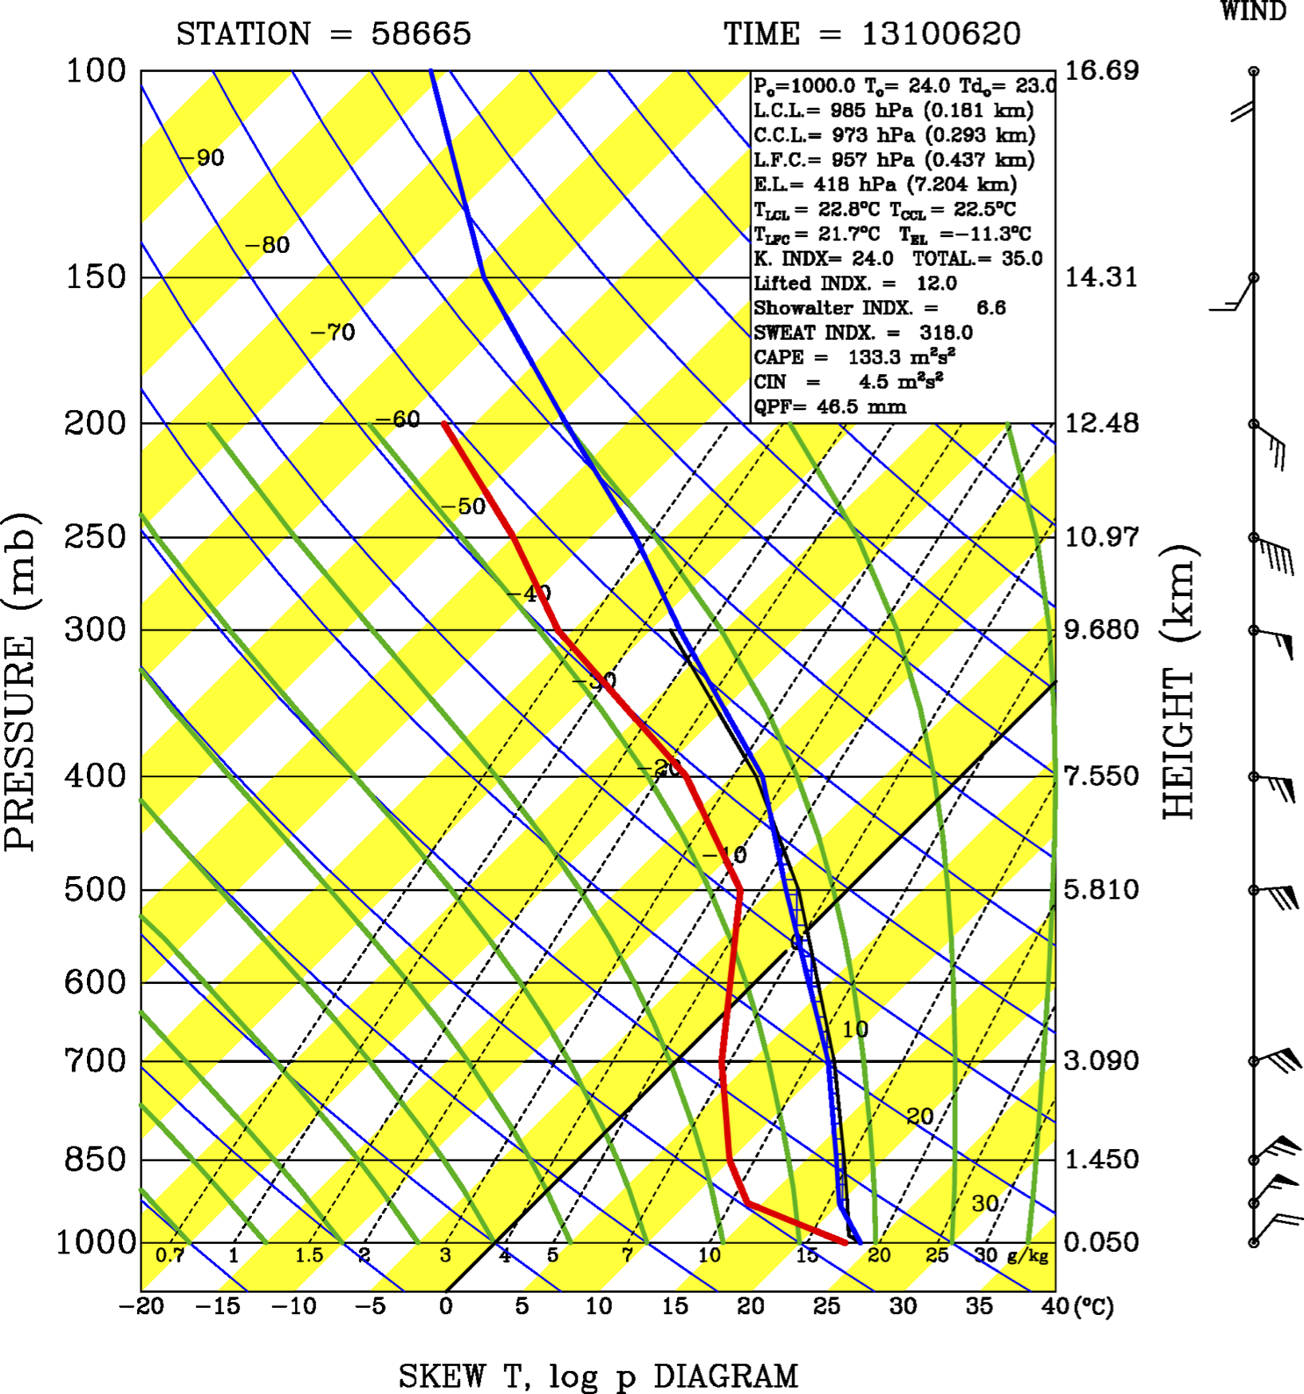
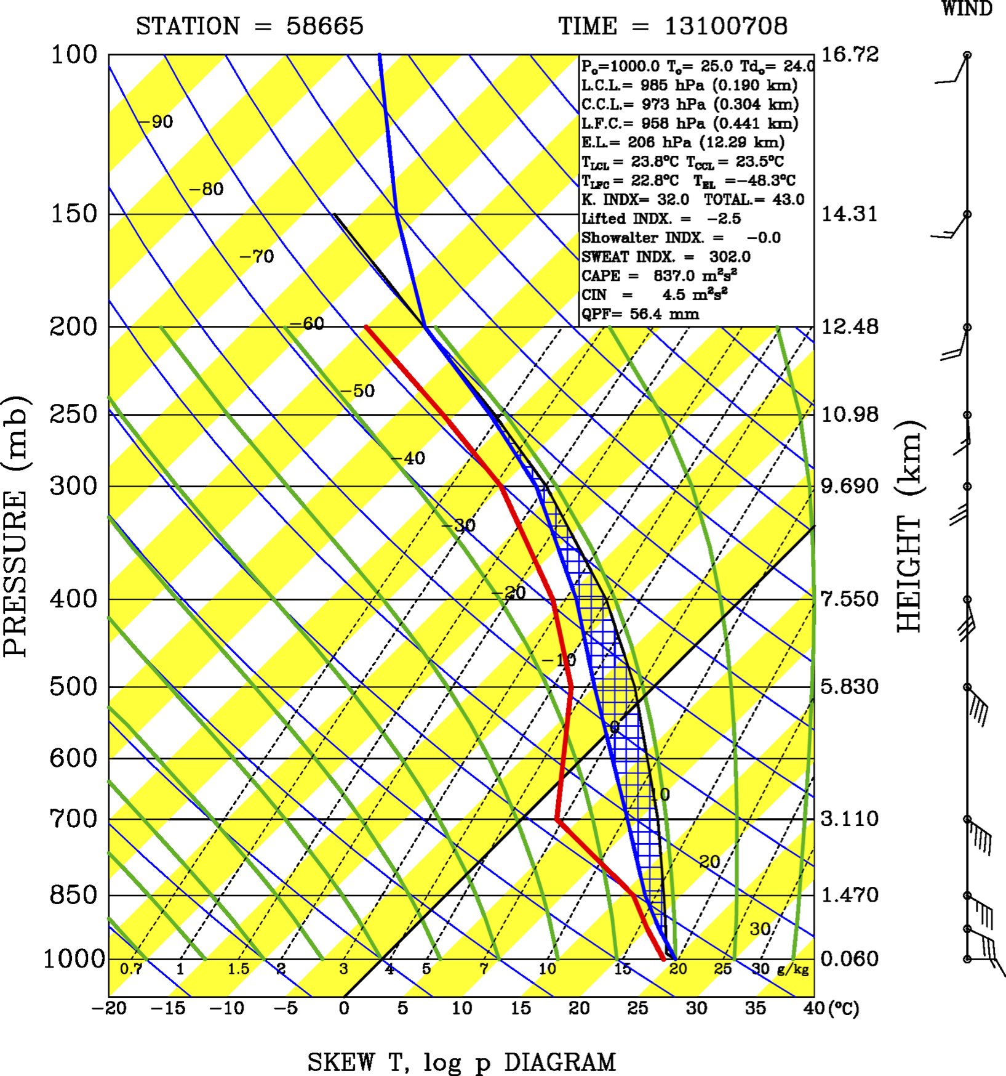
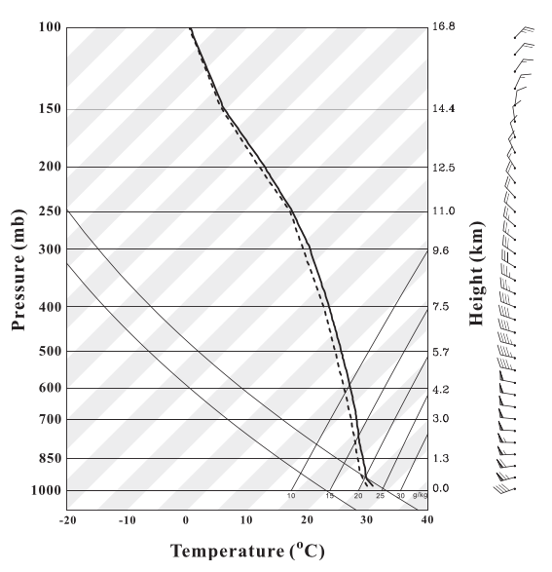
4. Result : Orographic effect mechanism
Time = 13100612
Time = 13100700
L.C.L.=181m
L.F.C.=437m
CAPE=133.3m²s²
L.C.L.=190m
L.F.C.=441m
CAPE=837.0m²s²
L. F. C = 437m
Air parcel
H < 180 m
Air parcel
XS
(Houze 2012)
Time for passing over terrain area
= Terrain width / speed < 0.5 h
Mean w < 0.1 m/s
Guess :
seeder-feeder mechanism might be responsible in this case
Yu and Cheng (2013)
Notes:
To Verify the low-level process, especially the near-ground process around XS area, the sounding data was used to see the condition of upcoming flow.
Although the cape of get greater at 12 am 7th, the lfc, lcl, only change for about several meters.
The sounding data at 12 pm was similar to the sounding provided by Yu and Cheng 2013, both these sounding showed a very moist air flow condition. The air parcel in this condition is easily to condense.
We do a roughly calculation about how the air parcel passed over XS area.
As the air parcel passed over the area, Time for passing over terrain area = Terrain width / speed < 0.5 h, Mean w < 0.1 m/s , the height that the air parcel can clime up was less than 180m. the air parcel can condense but not sufficient for convection.
We thus hypothesis that the rainfall enhancement at XS area was due to seeder-feeder mechanism. Which means, the pre-exist systerm rainfall, collect the cloud drop created by low-level flow while pass over the topography.

Slide 14
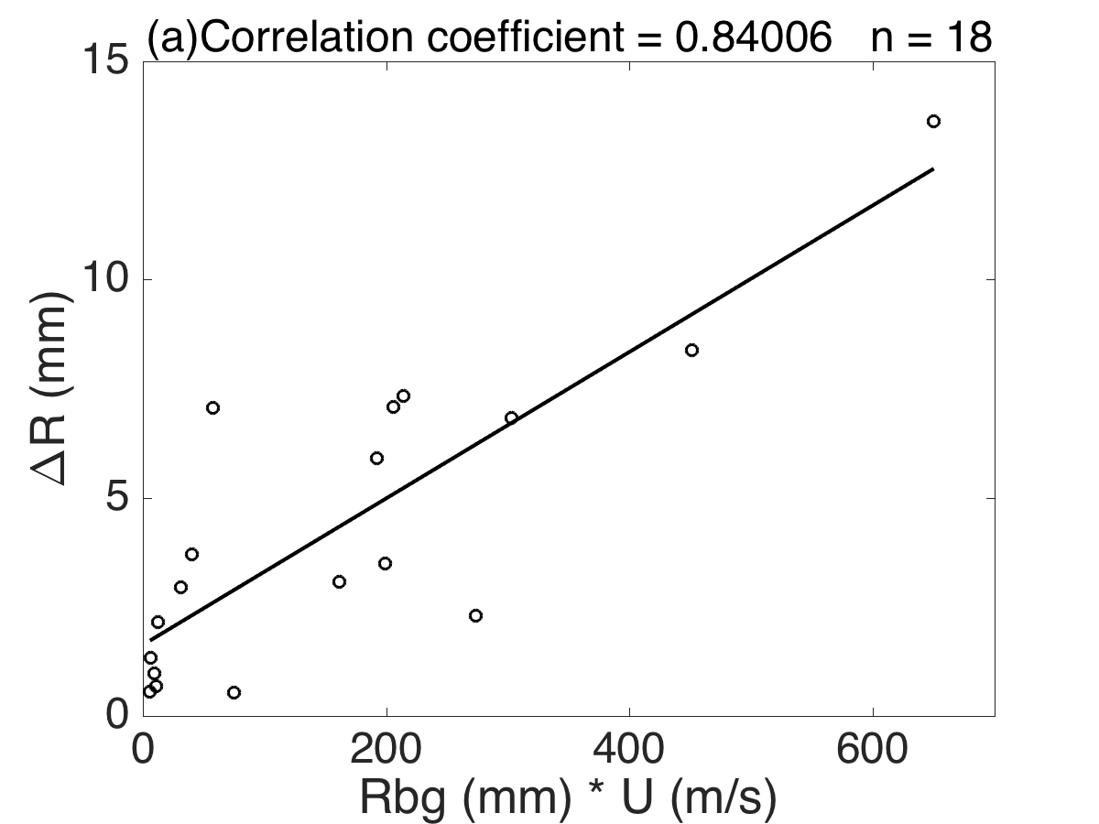
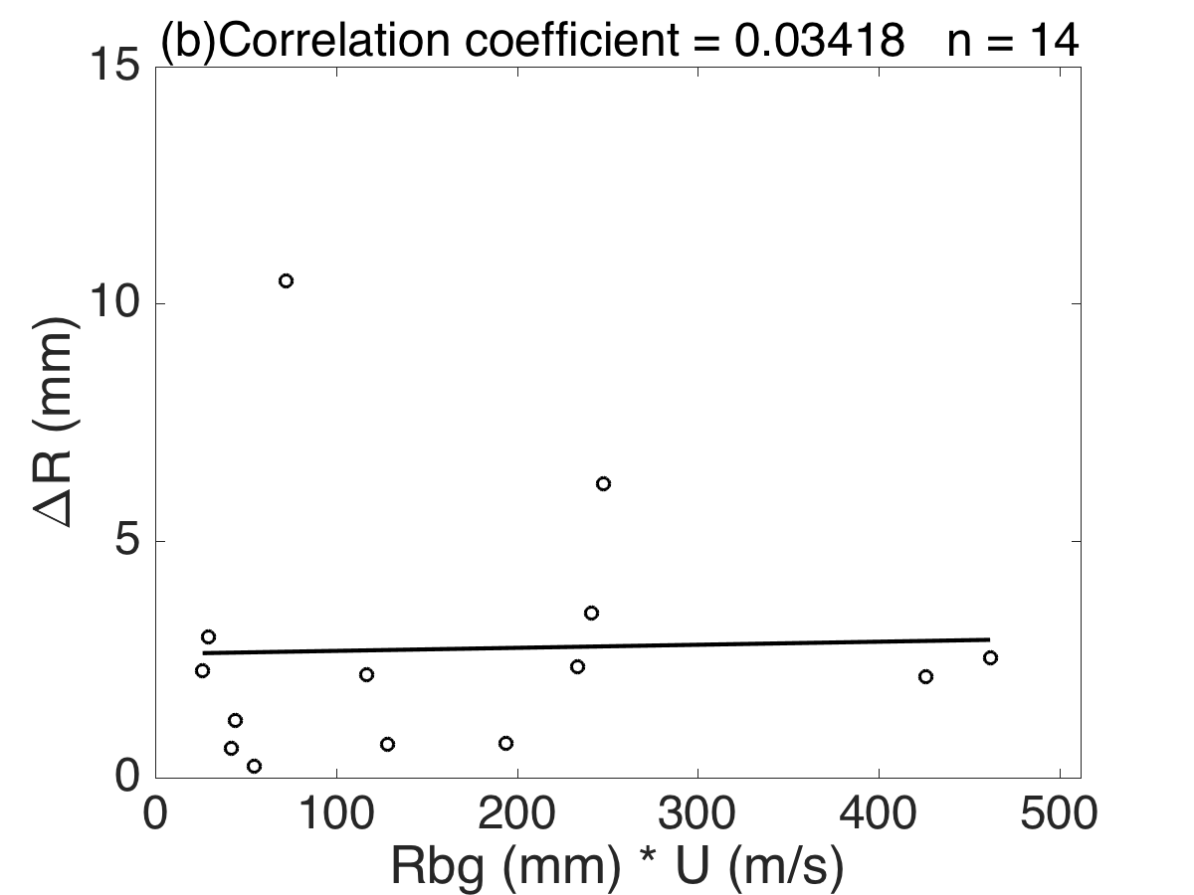
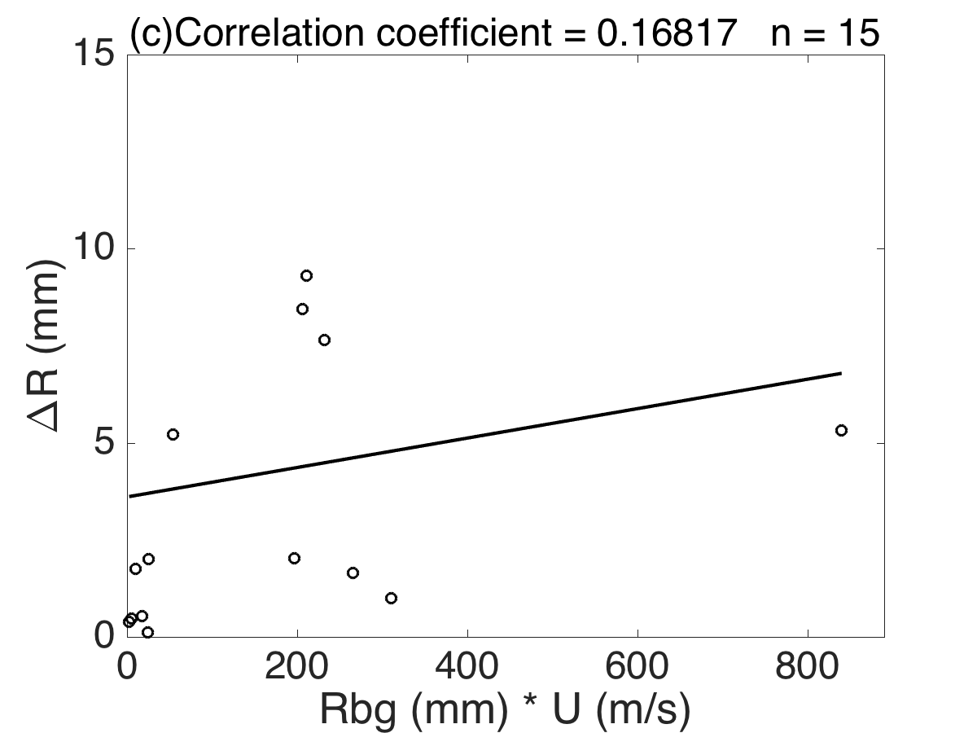
4. Result : Orographic effect & diagnose
Yu and Cheng （2013）：R_{bg}*U ∞ ∆R
R_{bg} ：rainfall in upstream area
U ：upcoming wind speed
∆R ：amount of rainfall enhancement
(Houze 2012)
XS
SMS1
SMS2
Notes:
Yu and Cheng 2013 diagnose method about seeder-feeder mechanism was applied.
the rainfall in upstream area stands for the back ground rainfall
U is the upcoming wind spped
Delta R was the amount of rainfall enhancement.
The result shows when rainfall enhancement happened at XS area, the relationship between delta R and background rainfall time U is significant.and can pass 99% confidence level(for n-2=16,0.59 is enough).But for both SMS1 and 2 area, there’s no significant linkage between them.

Slide 15
5. Conclusion and future work
Fitow’s rainband passed over eastern China topography, result in a heavy rainfall center around XS area (a small & low terrain )
Low level radar reflectivity and it’s tendency quite differ from upstream area
Tinny but frequent vertical motion around XS area not enough for low-level moist air parcel reach L.F.C. but enough for condensation
Using diagnose model, seeder feeder mechanism proved to be responsible for this rainfall enhancement around XS area.
Future work : Model testify
Notes:
Conclution

Slide 16
References
Liou Y C, Wang T C C, Tsai Y C, et al. Structure of precipitating systems over Taiwan’s complex terrain during Typhoon Morakot (2009) as revealed by weather radar and rain gauge observations[J]. Journal of Hydrology, 2013, 506:14-25.
Yu C K, Cheng L W. Distribution and Mechanisms of Orographic Precipitation Associated with Typhoon Morakot (2009)[J]. Journals of the Atmospheric Sciences, 2013, 70(9):2894-2915.
Yu C K, Tsai C L. Structural Changes of an Outer Tropical Cyclone Rainband Encountering the Topography of Northern Taiwan[J]. Quarterly Journal of the Royal Meteorological Society, 2017.
Tang X D, Yang M J, Tan Z M. A modeling study of orographic convection and mountain waves in the landfalling typhoon Nari, (2001)[J]. Quarterly Journal of the Royal Meteorological Society, 2012, 138(663):419-438.
Bao X, Davidson N E, Yu H, et al. Diagnostics for an Extreme Rain Event near Shanghai during the Landfall of Typhoon Fitow (2013)[J]. Monthly Weather Review, 2015, 143(9):150528113541009.
Jr R A H. Orographic effects on precipitating clouds[J]. Reviews of Geophysics, 2012, 50(1):1001.

Slide 17
Thank you!

